Slide 1
Lucy C. Laney Homecoming
Participant and Parent Meeting 2023

Slide 2
Meeting Agenda
Introduction of Homecoming Committee
Application Process & Payment Procedures
Miss Laney / Mr. Wildcat Cost & Attire
Homecoming Queen & King Cost & Attire
Class Queens & Kings Cost & Attire
Club Queens & Kings/Escorts Cost & Attire
Campaigning Requirements

Slide 3
Application Process
Each candidate must complete the application process. Applications will be handed out at the conclusion of this meeting.
Application Fee is $10 and must be paid to Appointed Chairperson (see packet).
All payments MUST be CASH only! No Cash App, Venmo, Zelle, etc.
Submissions and fees must be received by 3:05 pm on Tuesday, September 12th, 2023.
Each candidate will receive a confirmation letter via school email or delivered during 7th period on Friday, September 15th, 2023.

Slide 4
Coronation
Overview of Requirements

Slide 5
Coronation Overview
The Homecoming Committee works closely with all advisors for overseeing the planning and execution of the Coronation event which includes:
Rehearsals
Working with Choreographers, escorts, attire
Decorations/Florist
Program Handouts
Photographers, videographer, venue
Music and Production
Richmond County Board of Education
Parent Volunteers

Slide 6
Coronation Overview
Coronation will be held on October 19th at 6 pm in the Norman Bonner Gymnasium.
All Homecoming Court candidates and Class/Club winners MUST participate in Coronation.
Class and Club participants will be given TWO tickets for parents to attend the coronation free of charge.
Miss Laney, Mr. Wildcat, and HOCO King/Queen participants will be given FOUR tickets for parents to attend the coronation free of charge.
Additional tickets can be purchased at the door for $5 per person.
Children under 5 years old are free.
Masks are optional!

Slide 7
Coronation Practices
Practices will begin September 25th from 3:20 – 4:30 pm.
Practices will run Monday – Thursday from September 25th – October 18th.
Coronation practices will be held in the Old Gym.
BE ON TIME!
It is recommended that ladies bring the heels they plan on wearing or a similar pair to practice walking and dancing.

Slide 8
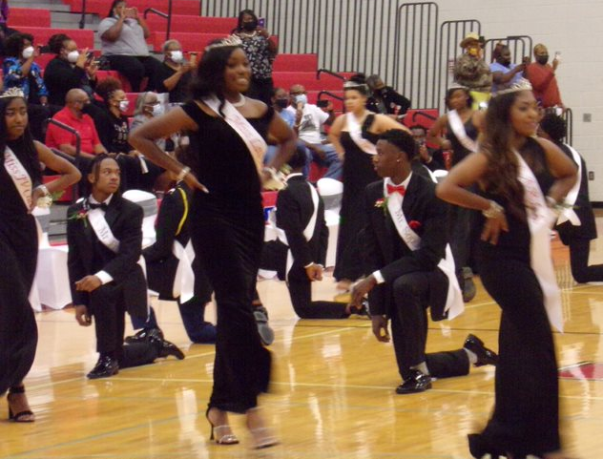
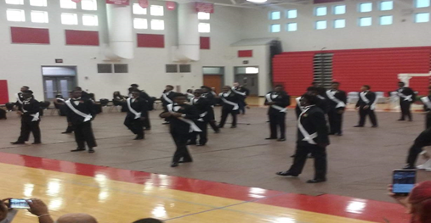
Coronation Dance
A traditional part of the Coronation which consist of various dances taught by Choreographer: Mr. Willingham
Girls Dance
Boys Dance
Couples Dance

Slide 9
Escorts/Class & Club Kings
Male advisors work closely with the Escorts/Kings during Coronation practices and on Coronation night.
Escorts and all KINGS may use the services of our business partner that handles the low cost for tuxedos for the Coronation at International Formal Wear.
The estimated tuxedo rental fee is $124.90. A down payment of $50.00 is required at the time of the measurement. Must have parent / guardian with valid ID. No deposit = no measurement! Remaining balance will be due at time of pickup.
Parents will be responsible for returning the Tux by the Sunday, October 22nd following the conclusions of Coronation, Parade, and Homecoming Game. If not returned by the date, there will be a set fee of $20.00 per day!

Slide 10
Homecoming Parade
Overview of Requirements

Slide 11
Homecoming Parade
Parade is on Saturday, October 21st at 10 am.
All court members (Class Kings/Queens, Club Kings/Queens, Escorts, Homecoming King/Queen Candidates, Miss Laney, and Mr. Wildcat) need to report to the parade grounds by 8:30 am.
If you are running for a particular club and you win, you are REQUIRED to participate in the parade.
Participants may choose to ride in a convertible, stand in a sun roof, or in a truck bed. No participant will be allowed to ride on the hood of a vehicle! School signs are provided!
You may throw candy out to parade attendees. Be sure to bring enough for the entire route!

Slide 12
Homecoming Parade
A Float will be used for Miss Laney/Mr. Wildcat.
Floats are for Class Kings/Queens.
Homecoming King/Queen Candidates will need to provide their own vehicle (convertible, sun roof, or truck bed).
Parade participants will not be allowed to come off the float, carriage, or vehicle. Participants MUST remain in place due safety reasons!
Parade participants will not be allowed to change their shoes or clothes for the duration of the parade.

Slide 13
Miss Laney & Mr. Wildcat
Overview of Requirements

Slide 14
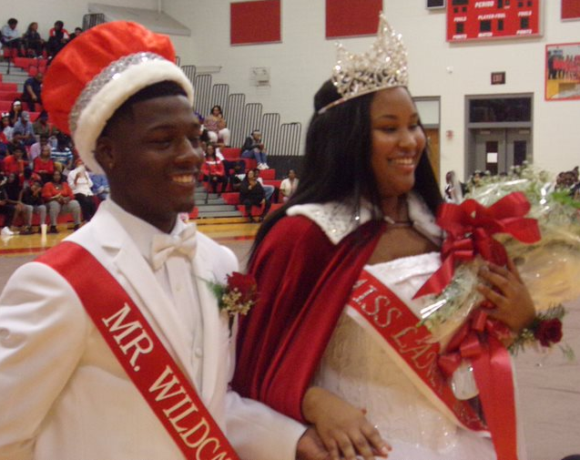
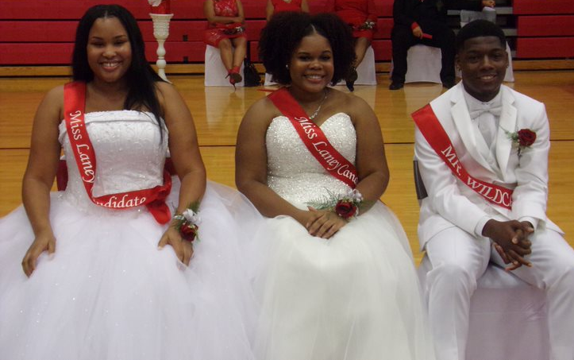
Miss Laney/Mr. Wildcat Candidates Estimated Total Cost
Application Fee: $10.00
Paid to the Appointed Chairperson (see packet).
HC Committee will cover the costs for:
Crowns
Sashes
Flowers

Slide 15
Academic & Discipline Expectations
Each candidate must be in good academic standing:
Cumulative grade point average of 90 or above
On track for graduation
18 credits and be labeled a Senior
Must have 3 letters of recommendation (see attached forms)
3 consecutive years completed at Lucy C. Laney High School
Must write and present original speech
Speech topic: “If Elected Miss Laney/Mr. Wildcat 2023-2024, I will serve my school and community by….
Speech should not exceed one typed page.
A copy of your speech must be submitted for approval to Mrs. Corley-Holmes
Each candidate must have a good discipline record:
No major infractions:
Major infractions include but are not limited to:
Any behavior that could result in suspension, expulsion, or the involvement of law enforcement.
Possession of a dangerous weapon.
Gang related activity.
Disruptive behavior.
Defacing or injuring school property.
Harassment, bullying. Cyber-bullying, hazing, and retaliation.
No more than 3 Unexcused absences No more than 5 tardies after September 11, 2023

Slide 16
Miss Laney Candidates Attire
Attire for HC game:
Candidates are required to wear a red pant suit with a white shirt.
No low or plunging neckline.
Attire for Parade and Coronation:
The gown must be an All White, full-length formal ball gown.
Low or plunging neckline or the back out is Not Permissible.
A strapless or spaghetti strap gown is permitted which covers the back entirely.
The gown cannot have a train or a train that is bustled.
Dresses need to be physically seen by Ms. Briscoe on or before October 12th!

Slide 17
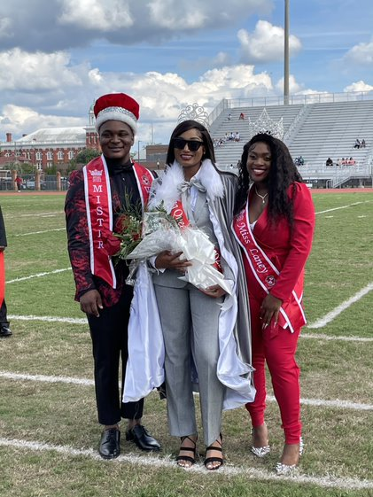
Mr. Wildcat Candidates Attire
Attire for HC game:
Candidates are required to wear a grey or black suit with a white shirt. May include some red (handkerchief, bowtie, tie, etc.)*
Attire for Parade and Coronation:
White Tuxedo
White Shirt
White Bow Tie
White Shoes

Slide 18
Mr. Wildcat and Miss Laney Speeches
Once candidates have received their approval letters via email, candidates will prepare a speech.
Speech practice will be on Oct 16-17 from 3:30 – 4:30.
Speeches will be presented on Wednesday, October 18th.
We will be on Morning Activity Schedule.
Candidates should dress in Sunday best/business attire.
After the speeches, students will vote in their homerooms:
The voting window will open at during HR and will close at 12 pm.
Students can only vote one time using their school email. Any personal or outside emails will not be accepted.

Slide 19
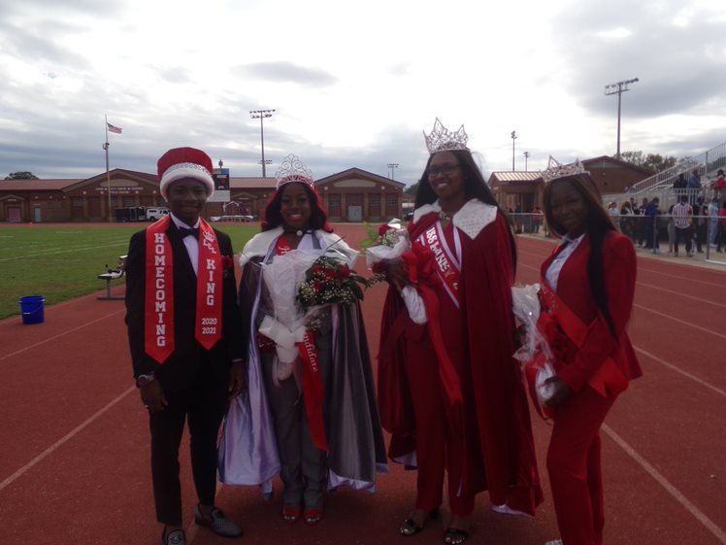
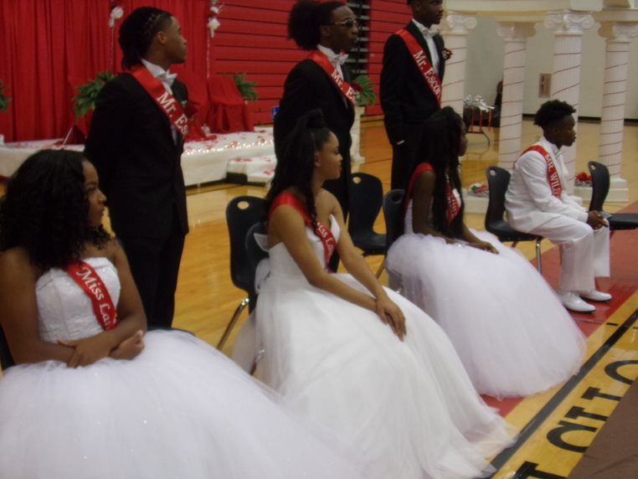

Slide 20
Homecoming King & Queen
Overview of Requirements

Slide 21
Homecoming King & Queen Candidates Estimated Cost
Application Fee: $10.00
Paid to the Appointed Chairperson (see packet).
HC Committee will cover the costs for:
Crowns
Sashes
Flowers

Slide 22
Academic & Discipline Expectations
Each candidate must be in good academic standing:
Cumulative grade point average of 85 or above
On track for graduation
Must have 18 credits and be labeled a Senior
2 years completed at Lucy C. Laney High School
Each approved candidate will be responsible for securing a vehicle for the parade on October 21st.
Each candidate must have a good discipline record:
No major infractions:
Major infractions include but are not limited to:
Any behavior that could result in suspension, expulsion, or the involvement of law enforcement.
Possession of a dangerous weapon.
Gang related activity.
Disruptive behavior.
Defacing or injuring school property.
Harassment, bullying. Cyber-bullying, hazing, and retaliation.
No more than 3 Unexcused absences
No more than 5 tardies after September 11th,2023

Slide 23
Homecoming Queen Candidates Attire
Attire for the HC game:
Candidates are required to wear a grey pant suit with a white shirt.
No low or plunging neckline.
Attire for the Parade and Coronation:
The gown must be an Silver /Gray, full-length formal gown.
Low or plunging necklines are Not Permissible
A strapless or spaghetti strap gown is permitted which covers the back entirely.
The gown cannot have a train or a train that is bustled.

Slide 24
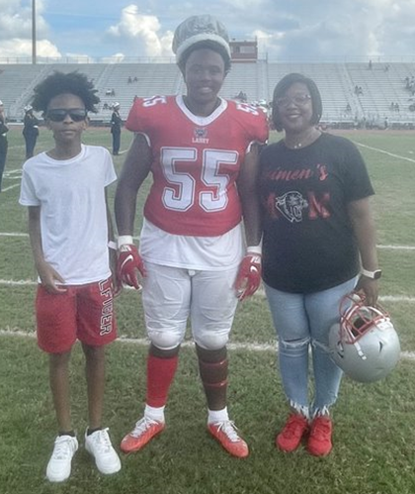
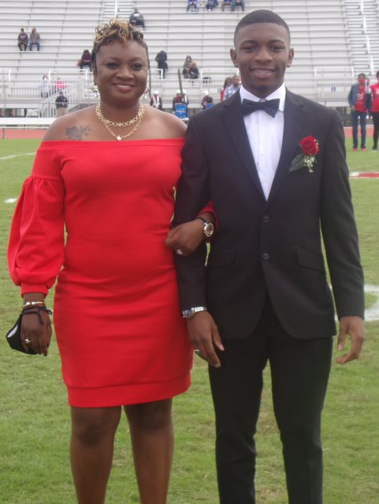
Homecoming King Attire
Attire for HC game:
Candidates are required to wear a grey or black suit with a white shirt, black tie, and black shoes.*
Attire for Parade and Coronation:
Black Tuxedo
Black Shoes
Silver/Grey Bow Tie
Silver/Grey Vest

Slide 25
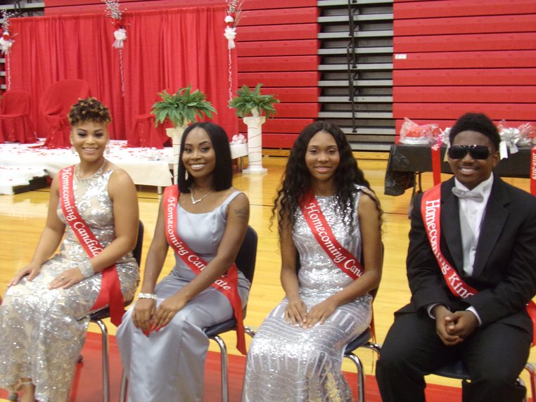

Slide 26
Class Kings and Queens
Overview of Requirements

Slide 27
Class Queens/Kings Estimated Costs
Application Fee: $10.00
Paid to the Appointed Chairperson (see packet).
Queen covers the costs for:
Crowns - $30
Sashes - $15
Flowers - $20
King covers the costs for:
Sashes - $15
Boutonniere - $10

Slide 28
Academic & Discipline Expectations
Each candidate must be in good academic standing:
Cumulative grade point average of 80 or above
On track for graduation
Must have the appropriate credits for grade level:
Senior – 18 credits
Junior – 11 credits
Sophomore – 5 credits
Each winning candidate will ride on the float in the parade on October 21st.
Each candidate must have a good discipline record:
No major infractions:
Major infractions include but are not limited to:
Any behavior that could result in suspension, expulsion, or the involvement of law enforcement.
Possession of a dangerous weapon.
Gang related activity.
Disruptive behavior.
Defacing or injuring school property.
Harassment, bullying. Cyber-bullying, hazing, and retaliation.
No more than 3 Unexcused absences
No more than 5 tardies after September 12, 2023

Slide 29
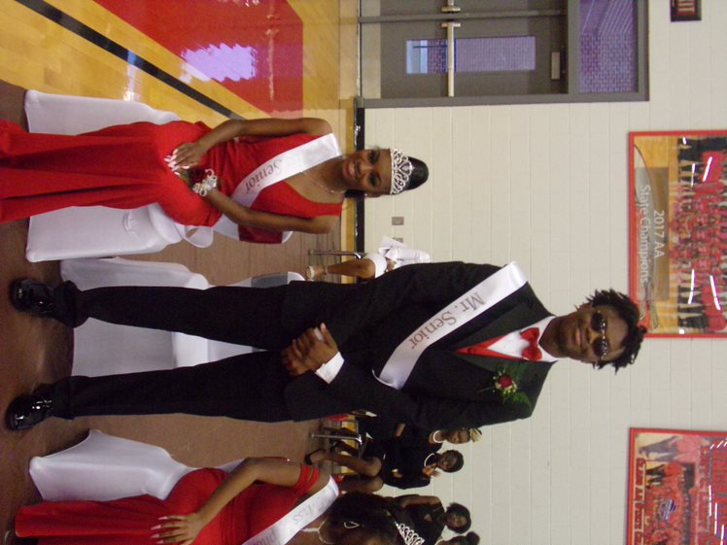
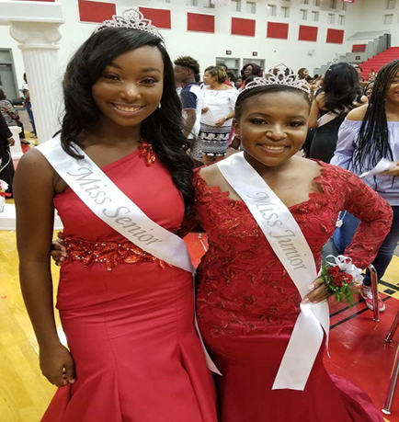
Class Queens Candidates Attire
Attire for Parade/Coronation:
Red Floor Length Gown
No plunging neckline

Slide 30
Class Kings Attire
Attire for Coronation/Parade:
Black Tuxedo
White Shirt
Red Bow Tie
Red Vest
Black Shoes

Slide 31
Club Kings and Queens
Overview of Requirements

Slide 32
Club Queens/Kings Estimated Costs
Application Fee: $10.00
Paid to the Appointed Chairperson (see packet).
Queen covers the costs for:
Crowns - $30
Sashes - $15
Flowers - $20
King covers the costs for:
Sashes - $15
Boutonniere - $10

Slide 33
Academic & Discipline Expectations
Each candidate must be in good academic standing:
Cumulative grade point average of 75 or above
On track for graduation
Must have the appropriate credits for grade level:
Senior – 18 credits
Junior – 11 credits
Sophomore – 5 credits
Each approved candidate will be responsible for securing a vehicle for the parade on October 21st.
Advisor must approve final choice and escort
Escorts should meet the same requirements as the Club King and Queen.
Escort should also have a recommendation from the advisor.
Each candidate must have a good discipline record:
No major infractions:
Major infractions include but are not limited to:
Any behavior that could result in suspension, expulsion, or the involvement of law enforcement.
Possession of a dangerous weapon.
Gang related activity.
Disruptive behavior.
Defacing or injuring school property.
Harassment, bullying. Cyber-bullying, hazing, and retaliation.
No more than 3 Unexcused absences
No more than 5 tardies after September 11, 2023

Slide 34
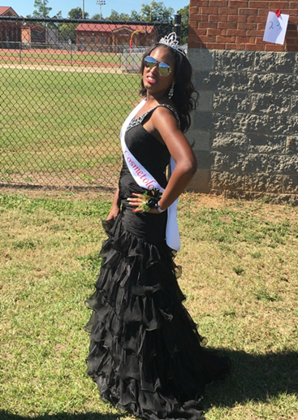
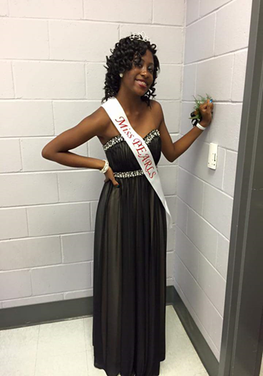
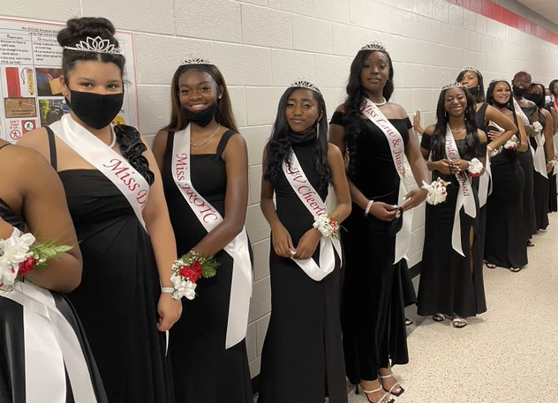
Club Queens Attire
Attire for Parade/Coronation:
The gown must be Black full-length formal gown.
A strapless or spaghetti strap gown is permitted which covers the back entirely.
The gown cannot have a train or a train that is bustled.
Gown may have some beading of sparkles

Slide 35
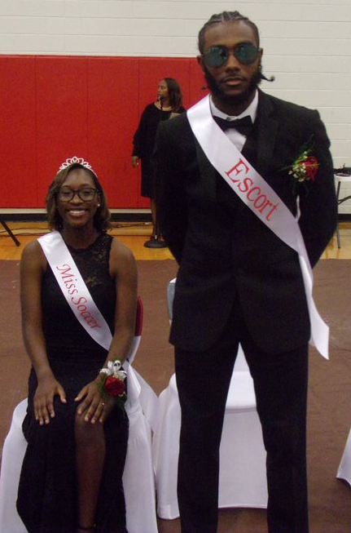
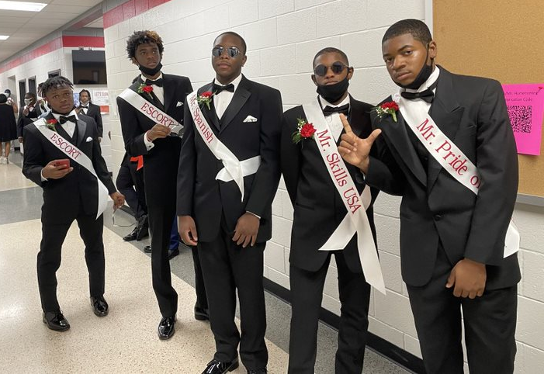
Club Kings Attire
Attire for Coronation/Parade:
Black Tuxedo
Black Vest
White Shirt
Black Bow Tie
Black Shoes

Slide 36
Campaigning
Overview of Requirements

Slide 37
Campaign Requirements
No one is allowed to campaign until AFTER receiving their approval letter on Friday, September 15th.
Class Kings and Queens will campaign on September 18th – September 21st.
Voting will be on September 22nd Voting will close at 12 pm.
Club Kings and Queens will campaign within their organization.
Voting will be done with members with the final selection turned in by the club advisor by Sept 22nd.
Homecoming King/Queen/Miss Laney/Mr. Wildcat will campaign Oct 11th – 17th.
Voting for Miss Laney/Mr. Wildcat will occur on Oct 18th in HR after the speech presentation.
Voting for Homecoming King/Queen will occur during Homeroom on Oct. 18th .

Slide 38
Campaign Requirements
Campaign posters must be approved BEFORE being hung in the halls by the student (no parents will be allowed to assist this student-led activity).
HC Committee members will review the poster and sign the back.
Posters should be hung AFTER school only!
Poster mounts are recommended to prevent damage to the walls.
Candidates should be creative in their gifts. Store-bought treats (sealed/wrapped) ONLY!

Slide 39
QUESTIONS We will now open the Floor for questions. Please raise Your hand and wait to be called on to ensure everyone gets a chance to ask their question and get the right information.

